Slide 1
Lecture 18 – Binary Search
Divide-and-conquer, Binary search procedures, iterative and recursive methods
Kok-Seng Wong | 2021

Slide 2
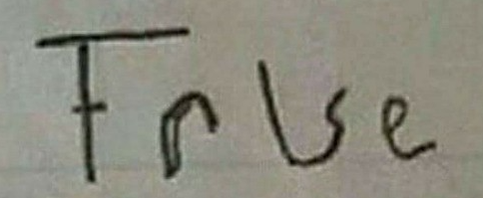
Motivation example 1

Slide 3
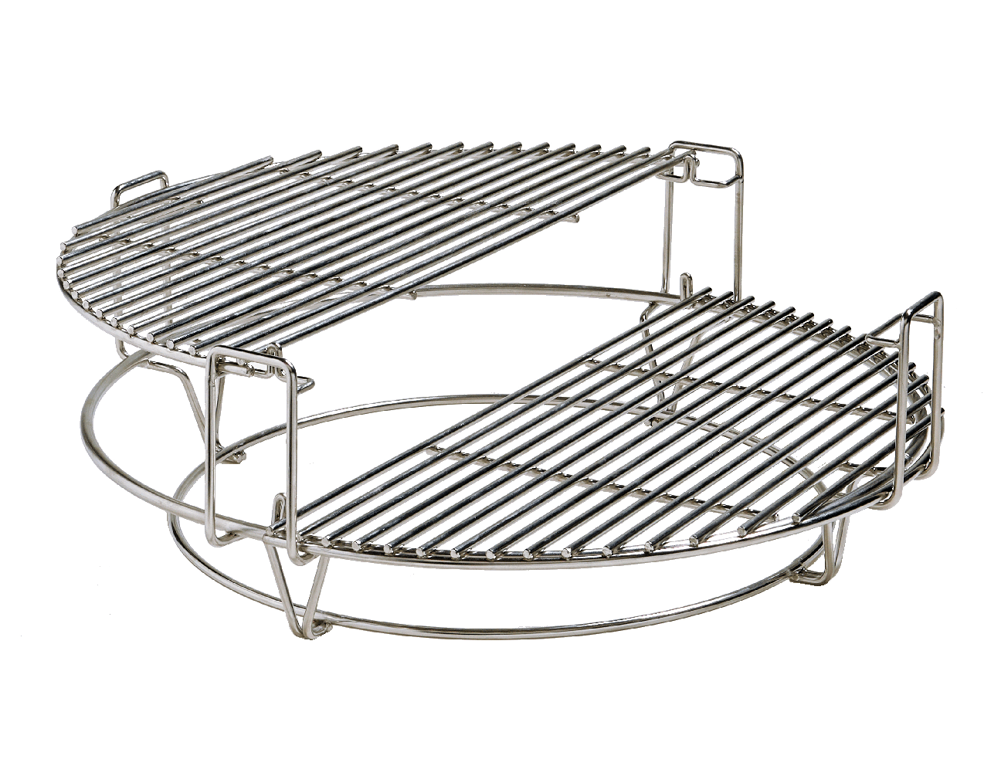
Motivation example 2

Slide 4
Learning outcomes
Upon the completion of this lecture, students will be able to:
explain the divide and conquer method, i.e., solving multiple subparts of a problem to solve the bigger problem.
understand binary search procedures and implement a search program in Python.
compare between iterative and recursive methods in search algorithms.

Slide 5
Divide-and-conquer algorithm

Slide 6
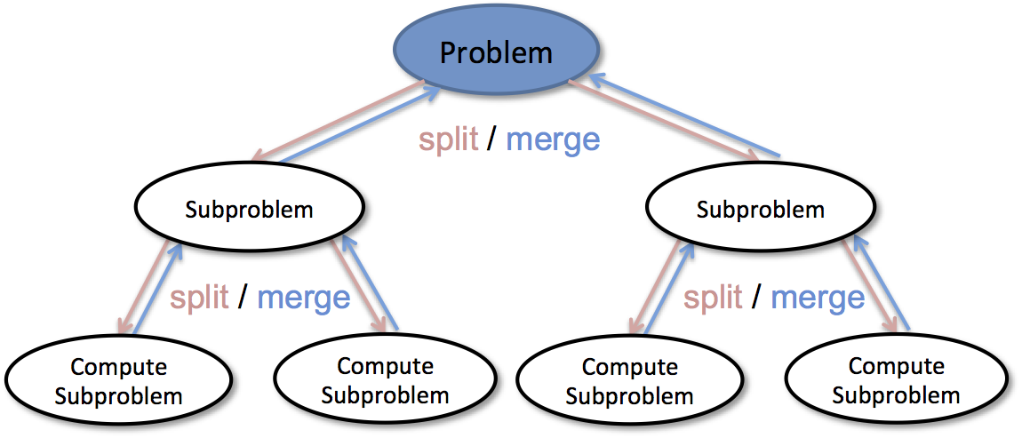
Divide-and-conquer
Objective: solving large problem
Idea: split the problem into smaller/simpler problems, solve them and then combine the results
[source]

Slide 7
Typical divide-and-conquer steps:
Divide: Break the given big problem into some sub-problem.
Conquer: Recursively solve these sub-problem.
Combine: Appropriately combine the results.

Slide 8
Divide-and-conquer algorithms
There are some standard algorithms that follows Divide and Conquer algorithm:
Binary search - a search algorithm that finds the position of a target value within a sorted array.
Quick sort
Merge sort
Sorting algorithm

Slide 9
Binary search

Slide 10
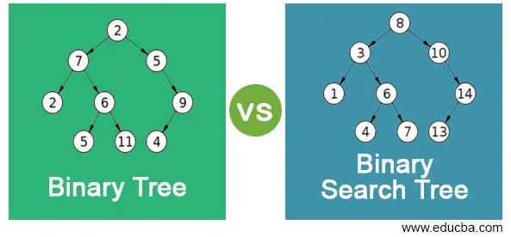
Binary tree vs. binary search tree

Slide 11
Binary search
Task: search a sorted array by repeatedly dividing the search interval in half.
Begin with an interval covering the whole array.
If the value of the search key is less than the item in the middle of the interval, narrow the interval to the lower half.
Otherwise narrow it to the upper half.
Repeatedly check until the value is found, or the interval is empty.

Slide 12

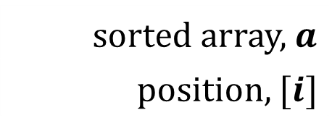

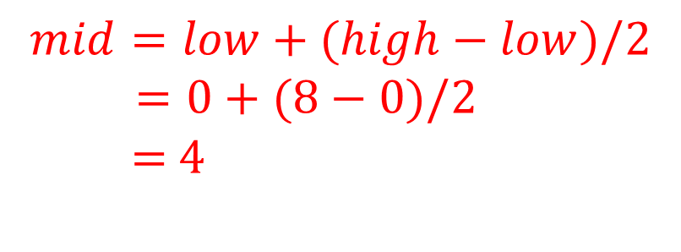


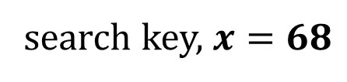
Binary search procedures
search key, $x=68$
sorted array, $a$
position, $[i]$
5 | 11 | 23 | 43 | 51 | 65 | 68 | 76 | 80
0 | 1 | 2 | 3 | 4 | 5 | 6 | 7 | 8
$$low$$
$$mid$$
$$high$$
To compute the position of the $mid$ of the array
$$mid=low+(high−low)/2$$
$=0+(8−0)/2$
$=$ 4

Slide 13


Binary search procedures
search key, $x=68$
$$a[4]=68?$$
$$NO$$
sorted array, $a$
position, $[i]$
5 | 11 | 23 | 43 | 51 | 65 | 68 | 76 | 80
0 | 1 | 2 | 3 | 4 | 5 | 6 | 7 | 8
$$low$$
$$mid$$
$$high$$

Slide 14


Binary search procedures
search key, $x=68$
$$a[4]<68?$$
$$Yes$$
sorted array, $a$
position, $[i]$
5 | 11 | 23 | 43 | 51 | 65 | 68 | 76 | 80
0 | 1 | 2 | 3 | 4 | 5 | 6 | 7 | 8
$$low$$
$$mid$$
$$high$$

Slide 15
Binary search procedures
search key, $x=68$
$$a[4]<68?$$
$$Yes$$
sorted array, $a$
position, $[i]$
5 | 11 | 23 | 43 | 51 | 65 | 68 | 76 | 80
0 | 1 | 2 | 3 | 4 | 5 | 6 | 7 | 8
$$mid$$
$$high$$
Binary search halves the searchable items

Slide 16

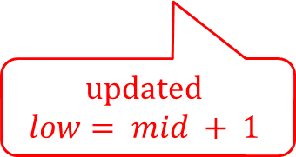
Binary search procedures
search key, $x=68$
sorted array, $a$
position, $[i]$
5 | 11 | 23 | 43 | 51 | 65 | 68 | 76 | 80
0 | 1 | 2 | 3 | 4 | 5 | 6 | 7 | 8
$$low$$
$$high$$
updated
$$low= mid + 1$$

Slide 17



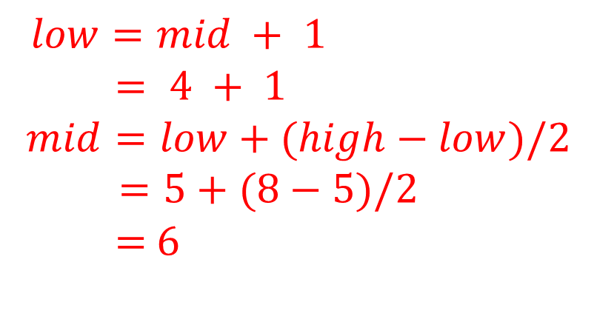
Binary search procedures
search key, $x=68$
sorted array, $a$
position, $[i]$
5 | 11 | 23 | 43 | 51 | 65 | 68 | 76 | 80
0 | 1 | 2 | 3 | 4 | 5 | 6 | 7 | 8
$$low$$
$$mid$$
$$high$$
$$low=mid + 1$$
$= 4 + 1$
$$mid=low+(high−low)/2$$
$=5+(8−5)/2$
$=$ 6
updated $mid$
Integer value of 6.5

Slide 18



Binary search procedures
search key, $x=68$
$$a[6]=68?$$
$$Yes$$
sorted array, $a$
position, $[i]$
5 | 11 | 23 | 43 | 51 | 65 | 68 | 76 | 80
0 | 1 | 2 | 3 | 4 | 5 | 6 | 7 | 8
$$low$$
$$mid$$
$$high$$
The target value 68 is stored at location 6.

Slide 19
Group discussion

Slide 20
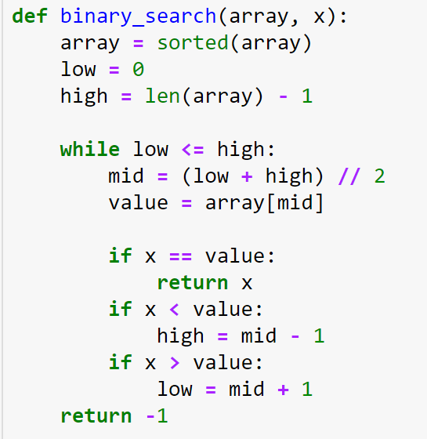

Binary search: iterative method
Sorting the array
To compute the position of the $mid$ of the array

Slide 21
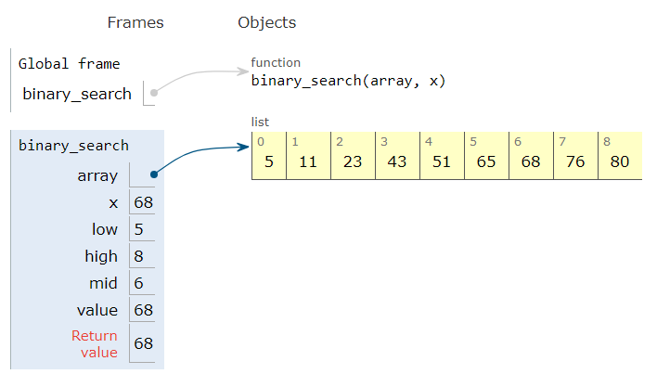
Binary search – python tutor
binary_search((5, 11, 23, 43, 51, 65, 68, 76, 80), 0, 8, 68)
iterative method
[Demo]

Slide 22
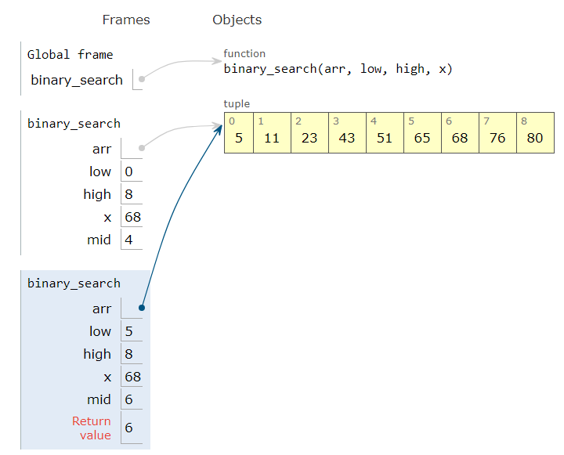
Binary search – python tutor
binary_search((5, 11, 23, 43, 51, 65, 68, 76, 80), 0, 8, 68)
recursive method
[Demo]

